Slide 1
Web Designing Basics
Starter note for web design beginners

Slide 2
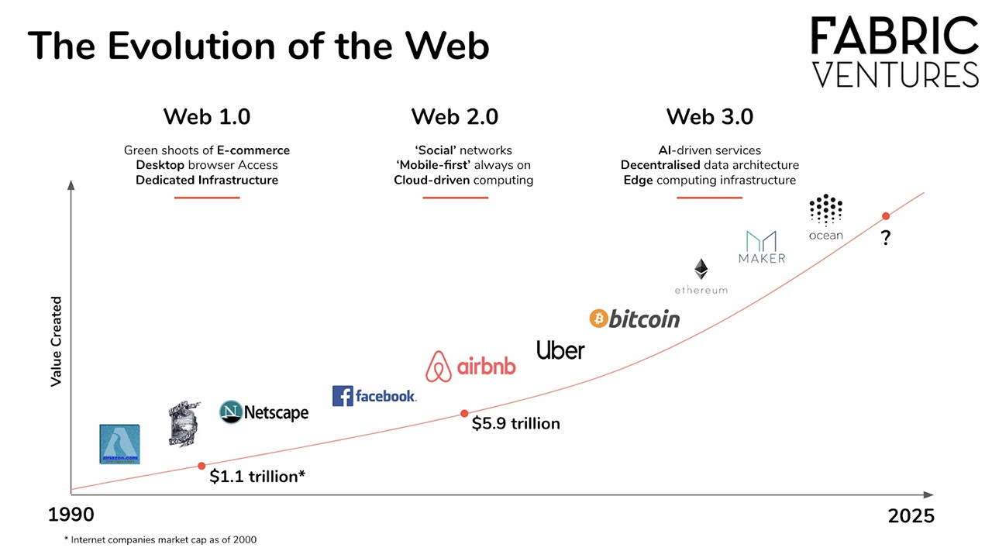
Welcome to the Web

Slide 3
Keywords of today’s discussion
Web and Internet
Careers in Web – Lets go to LinkedIn
Frontend, Backend and Full Stack
Tech Stacks – MERN Vs LAMP
Structure of web – webpage, website and links
The Basics – What web is made up of?
HTML, CSS, Javascript
Frameworks?
APIs?
The Learning Curve with me-Programming or coding?

Slide 4
Web and Internet

